Slide 1

Crime in the USA
Daria Dubovskaia

Slide 2
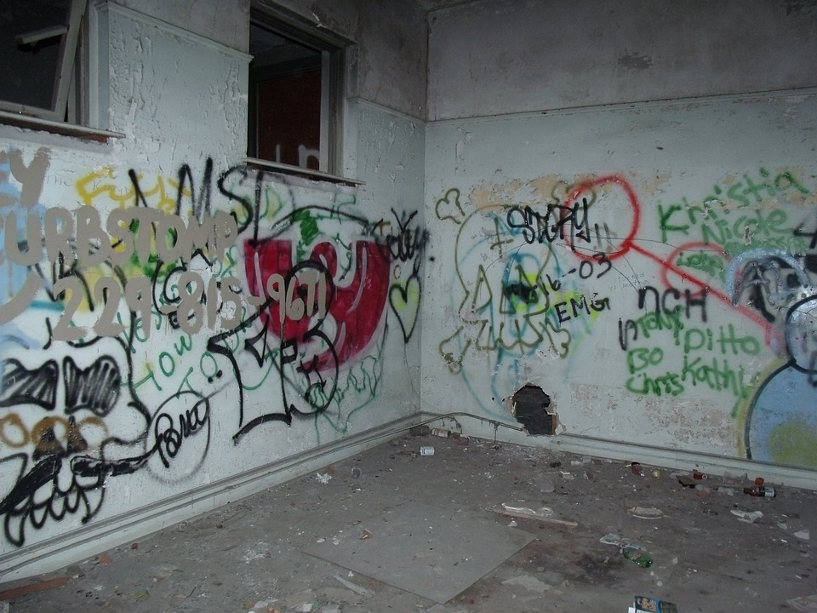


Agenda
Overview
Data
Tidy data
Exploratory analysis
Challenges

Slide 3

Overview

Slide 4
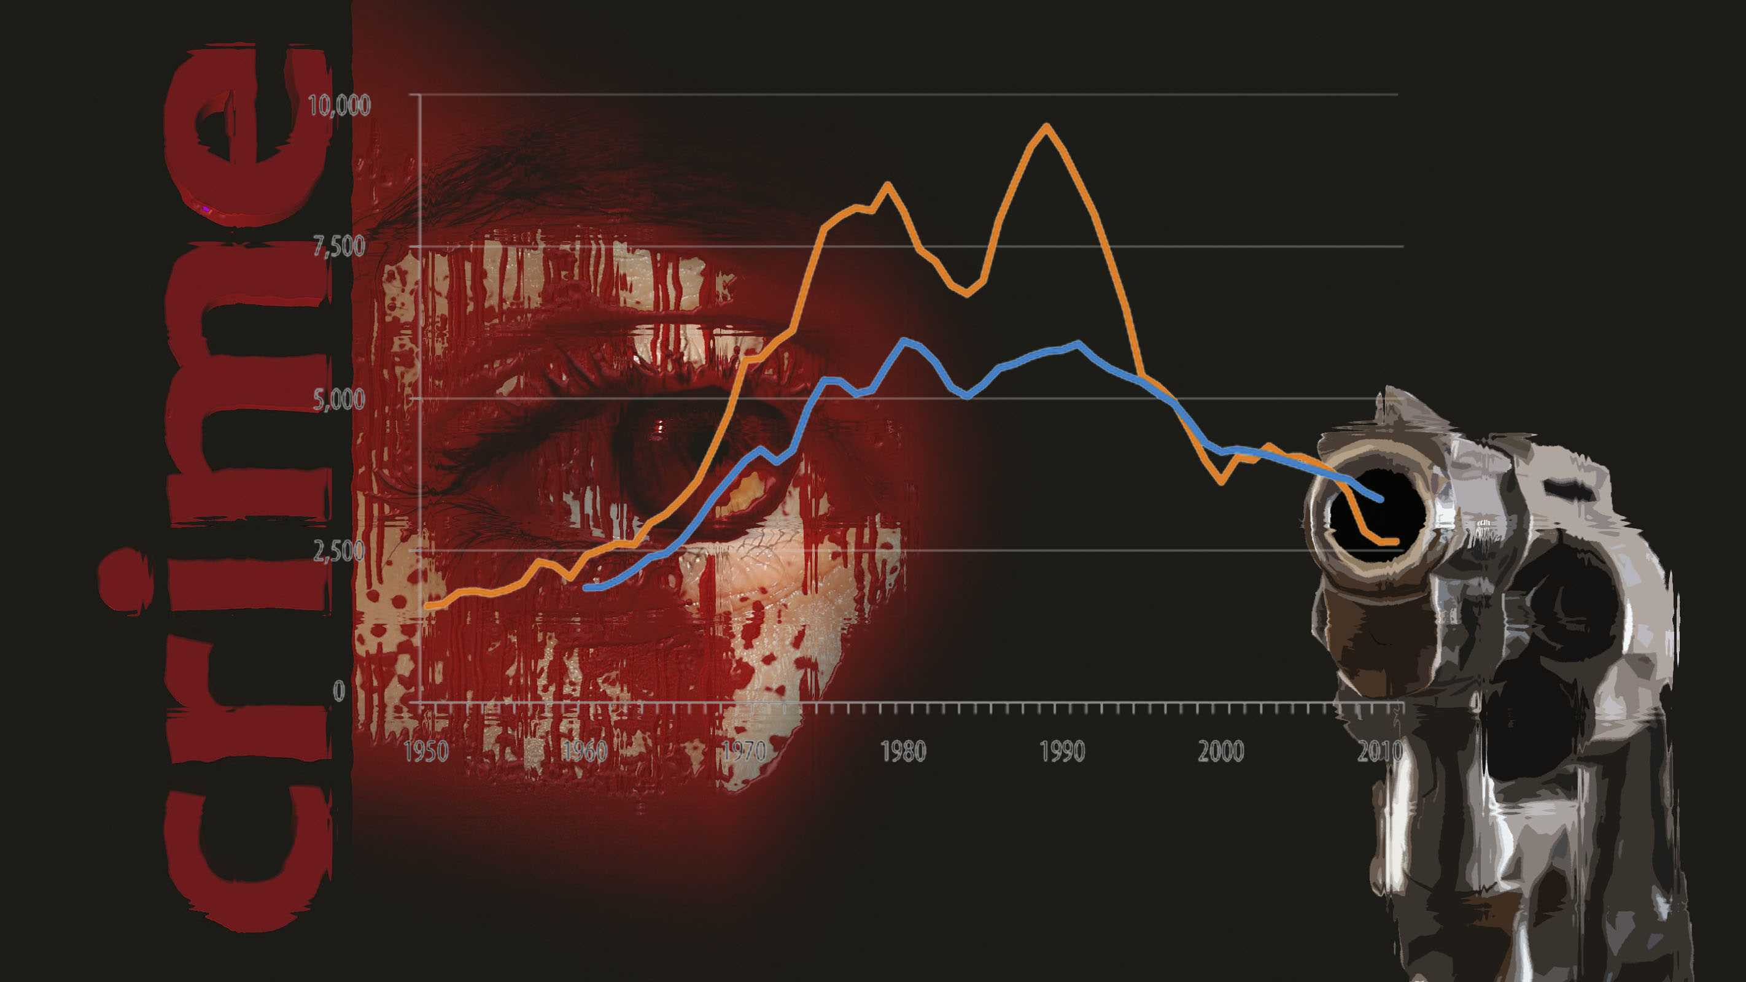
“With all the opportunities for a better life in the US comes the question of safety”
What is the safe state to move from New York City?
What state is the crime leader?
What is the most common type of crime?
Analyze the most dangerous states by the type of crime.
This Photo by Unknown Author is licensed under CC BY-SA-NC

Slide 5
Data

Slide 6
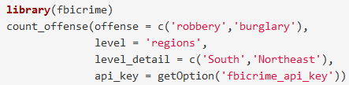
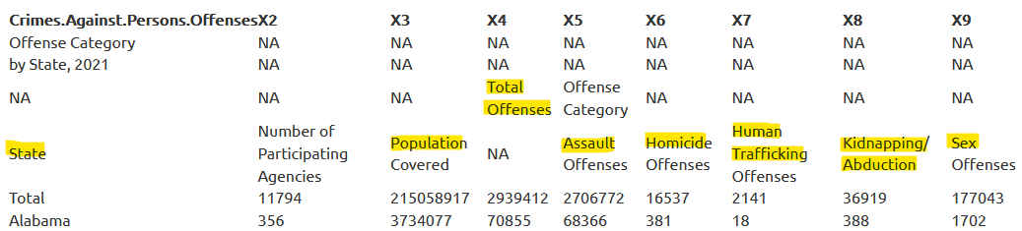
FBI Crime Data Explorer
Load: xlsx, API, user’s GitHub, R libraries, DB
Crime in the United States Annual Reports
2020, 2021 years
3 Tables for each year: Crime against person, property, society

Slide 7
Tidy Data

Slide 8
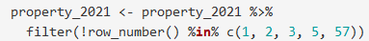
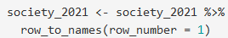
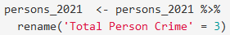
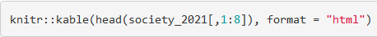
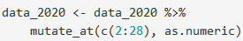
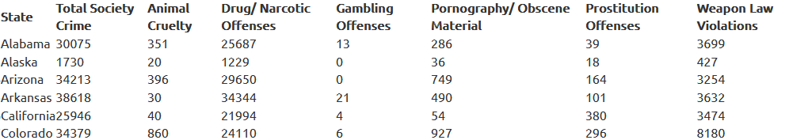
Steps:
Remove empty rows/columns, rename
Combine data frames by year (2020, 2021)
Add columns “Total offenses”/Year for each year

Slide 9
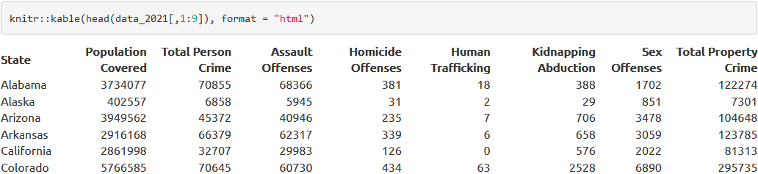
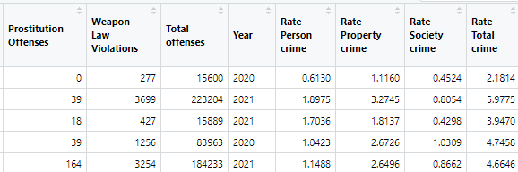
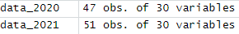
Steps:
Rename columns, rows
Merge 2020, 2021 in one data frame

Slide 10
Exploratory analysis

Slide 11
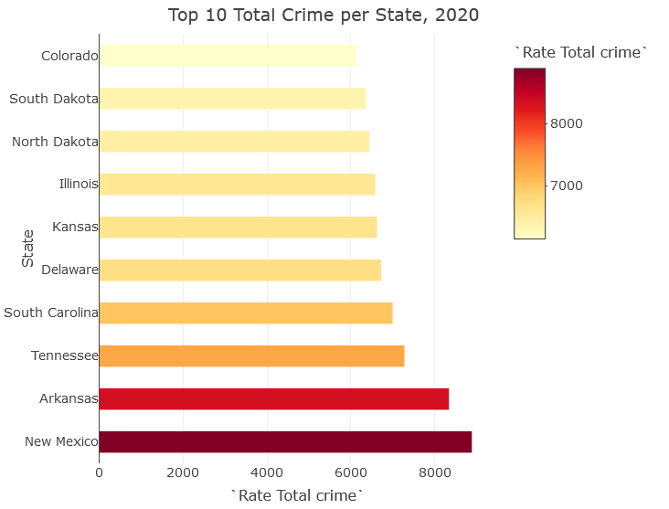
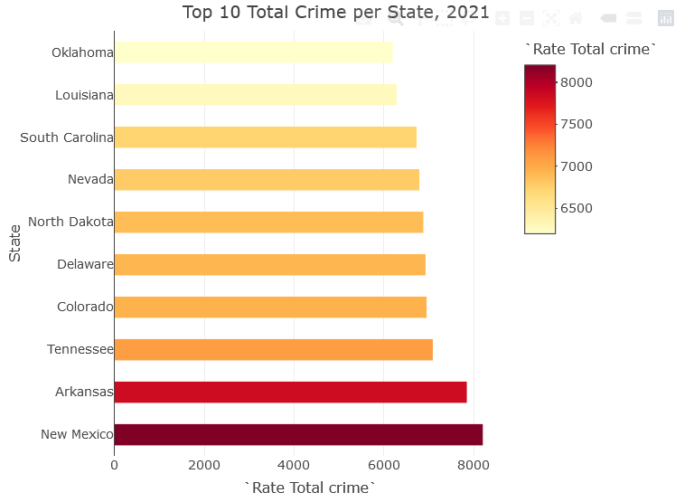
The most dangerous states

Slide 12
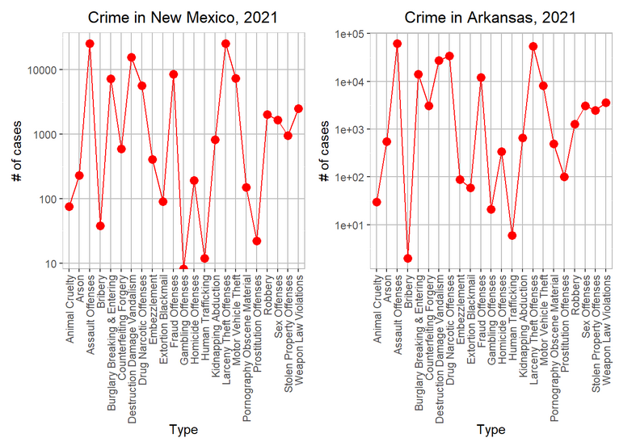
The most dangerous states

Slide 13
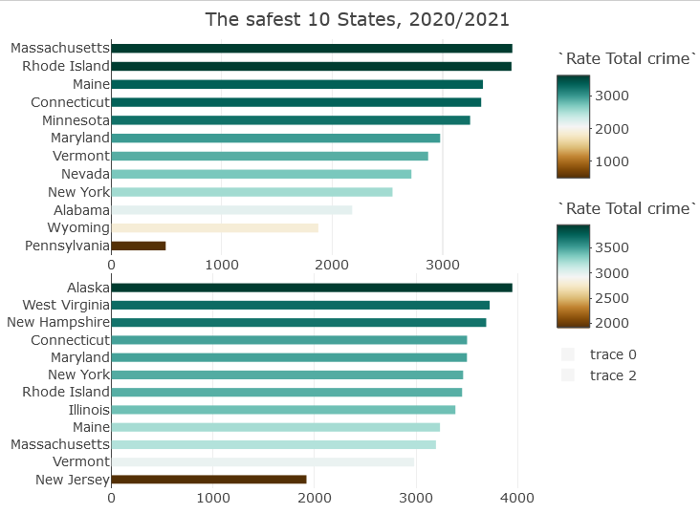
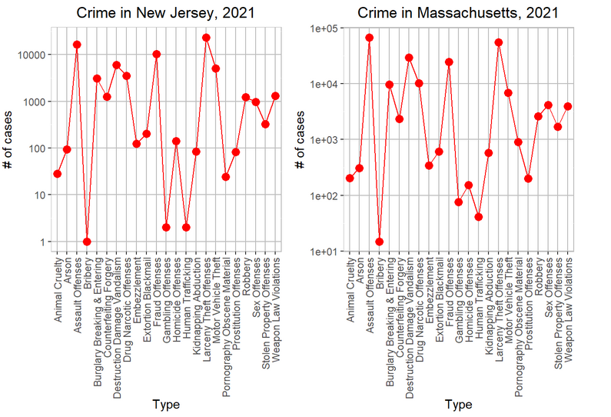
Safe states

Slide 14
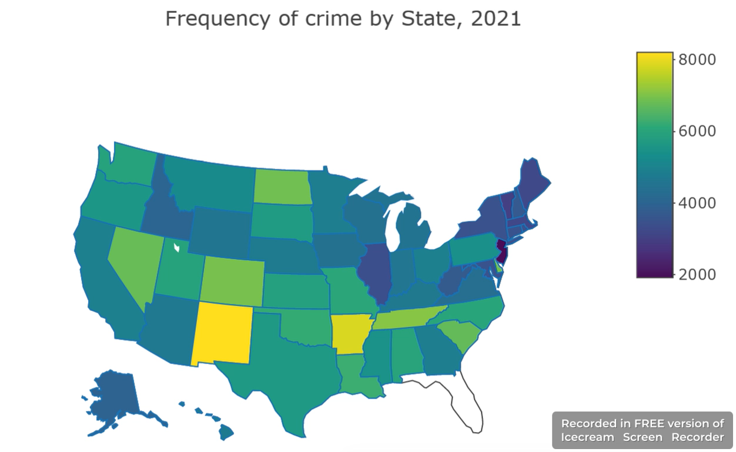
Crime Map

Slide 15
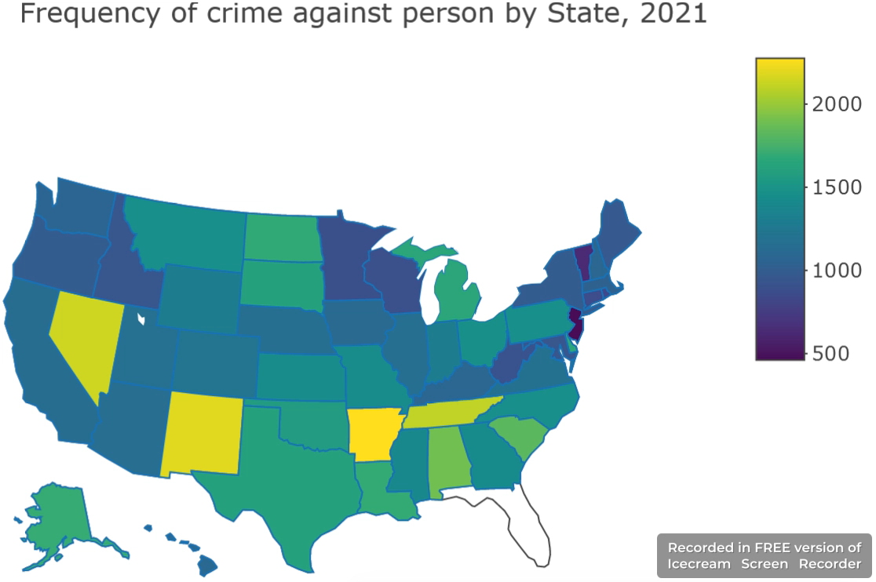
Crime Against Person

Slide 16
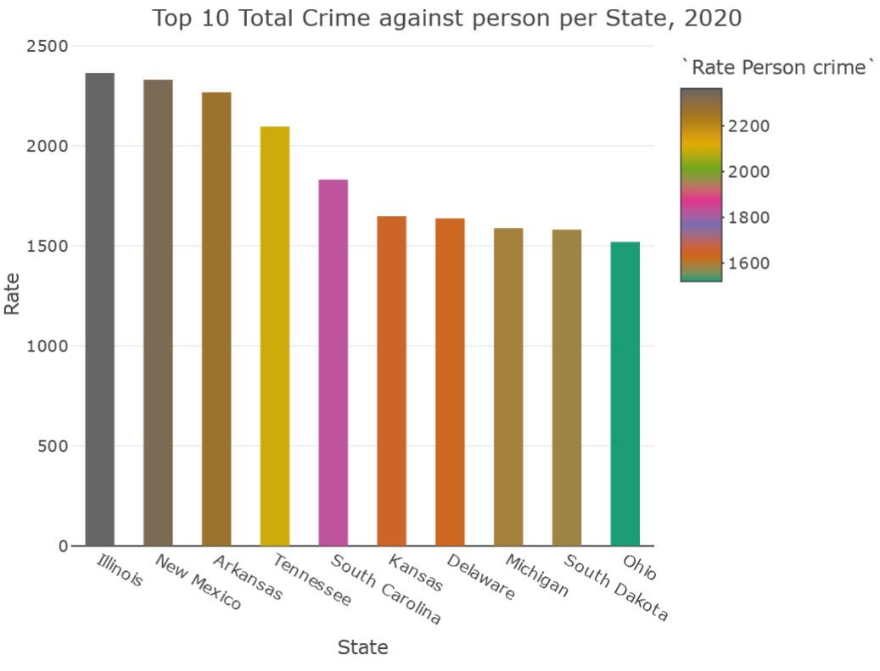
Crime Against Person

Slide 17
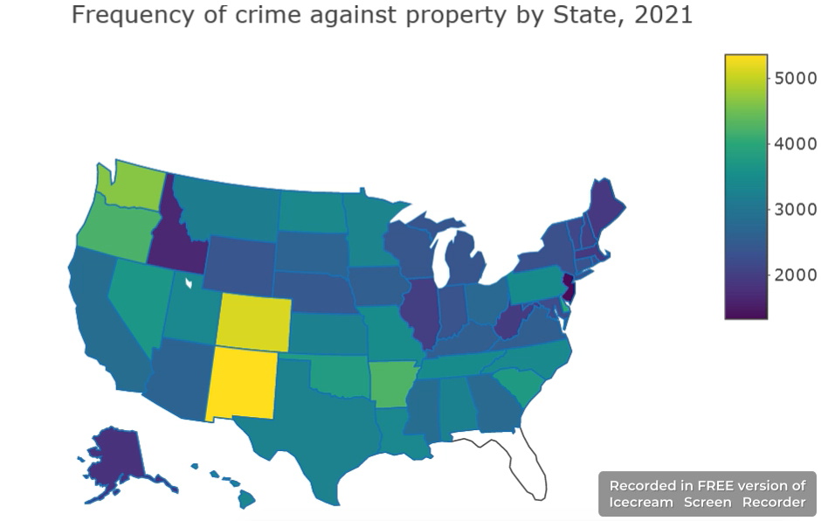
Crime Against Property

Slide 18
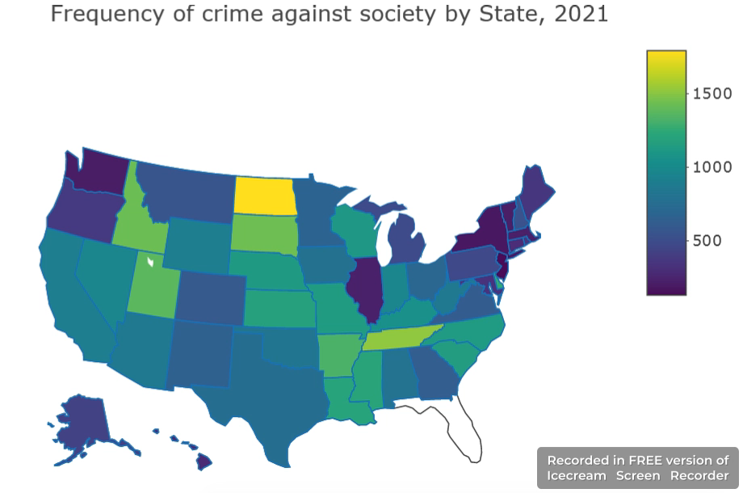
Crime Against Society

Slide 19
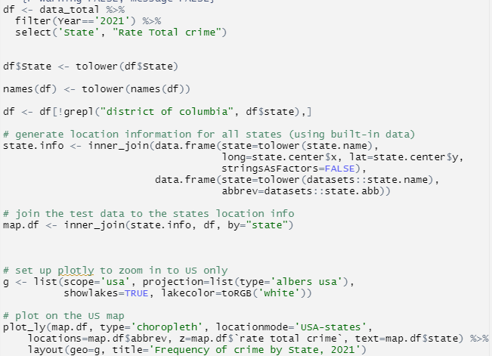
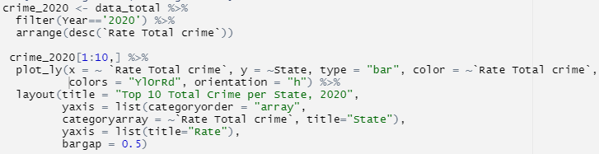
Code example

Slide 20
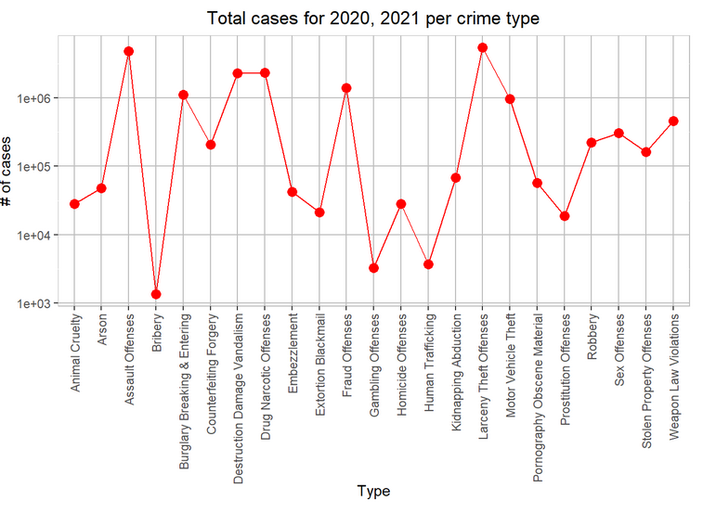
The most common crime

Slide 21
Difficulties

Slide 22
Issue/Solution:
Problem: Working with FBI API. Solution: custom R libraries
Problem: plot_ly features. Solution: forums
Problem: no location info in the data to create interactive map. Solution: generate map from R, map it with our data frame

Slide 23

Conclusion
2020/2021 years, situation changed drastically. Plots for 2020/2021 were totally different
Dangerous: New Mexico, Arkansas, North Dakota (society crime), Colorado, Nevada
Safe: East Coast (New Jersey, Vermont, etc)
The crime is mostly related to not deadly type
New tools: openxlsx, plot_ly, ggthemes, kable
We should look further at the data for 2018, 2019, 2022 together with demographic info

Slide 24

Resources
“How Safe Is The US: Crime Levels In The US” https://www.moovaz.com/blog/how-safe-is-the-us-2/
FBI website https://crime-data-explorer.app.cloud.gov/#
Crime Open Database https://osf.io/zyaqn/
Plotly library https://plotly.com/r/

